Slide 1


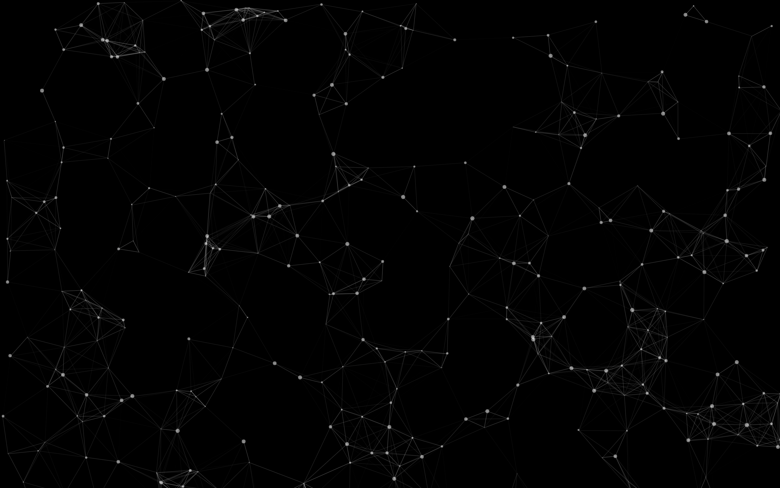
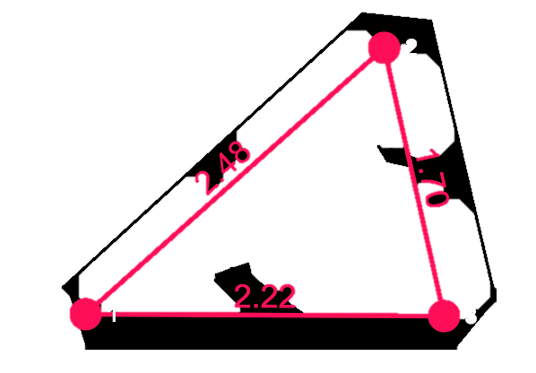
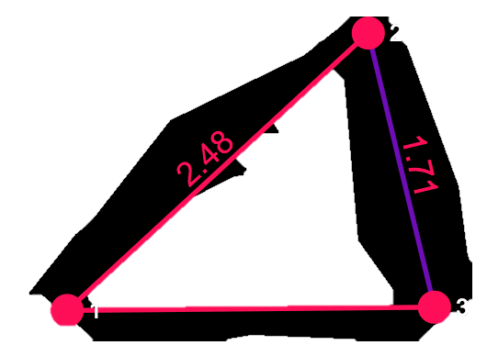
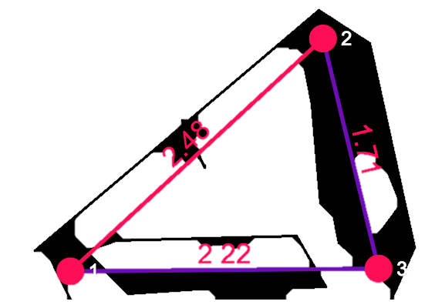
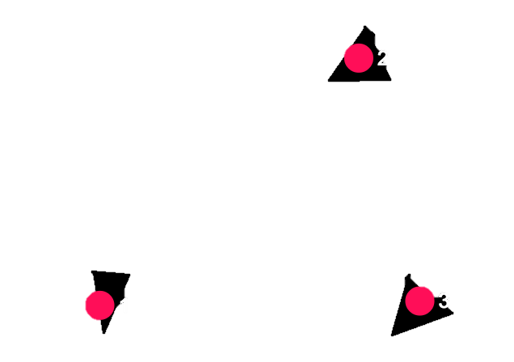
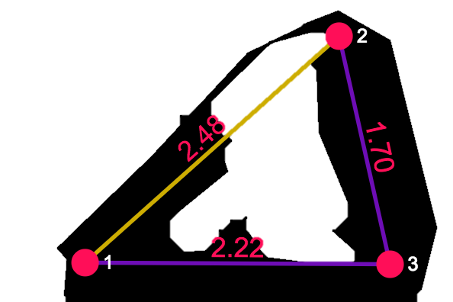
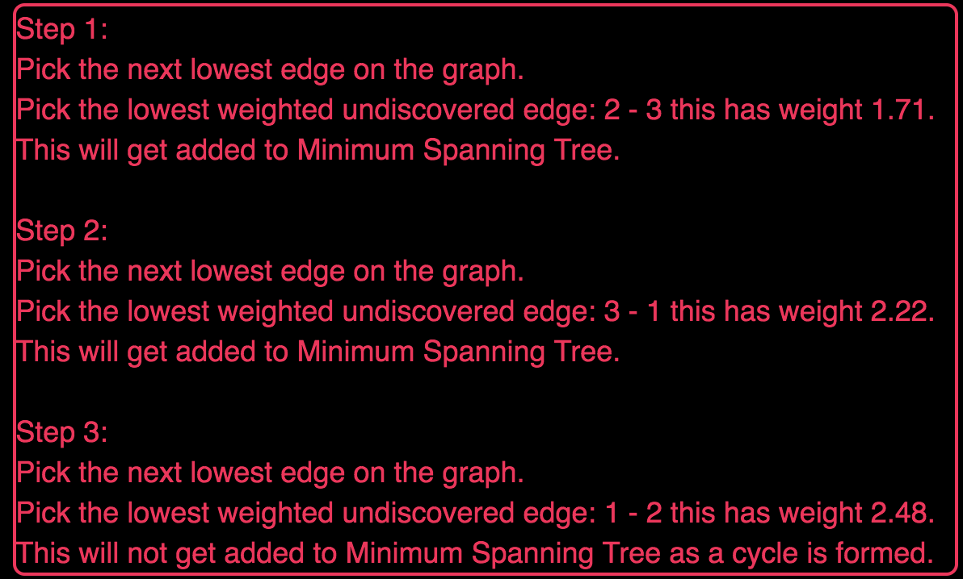
A tool for teaching graph algorithms
Graph Algorithm Teaching Tool
Emmanuel Odame-Asante Mike Sanderson
Create your own graph:
Execute an algorithm on your created graph:
Visualise step-by-step execution from coloured edges
Left Click to create nodes:
Shift Click to create edges:
Step 1:
Step 2:
Features of Graph Algorithm Teaching Tool:
Learn the inner workings of popular Graph Algorithms by running them on your created graph!
Interactive web application built with the latest industry standard technologies such as React, Node.js, jQuery, HTML 5, CSS 3 and JavaScript (ES6).
Dijkstra’s, Kruskal’s and Prim’s graph algorithms supported.
Comprehensive teacher tool illustrating how the algorithm works packed with features which promotes user friendliness.
Ability to save your created graph for later using JSON deserialization.
Customizable aesthetic colour theme for the users. Developed with Bootstrap 3.
‘First time visit’ tour guide so user gets instructions on how to use the application.
Informational ‘wiki’ page for all the algorithms describing the algorithms in detail.
Step 3:
Learn the algorithm from descriptive text:

